Slide 1
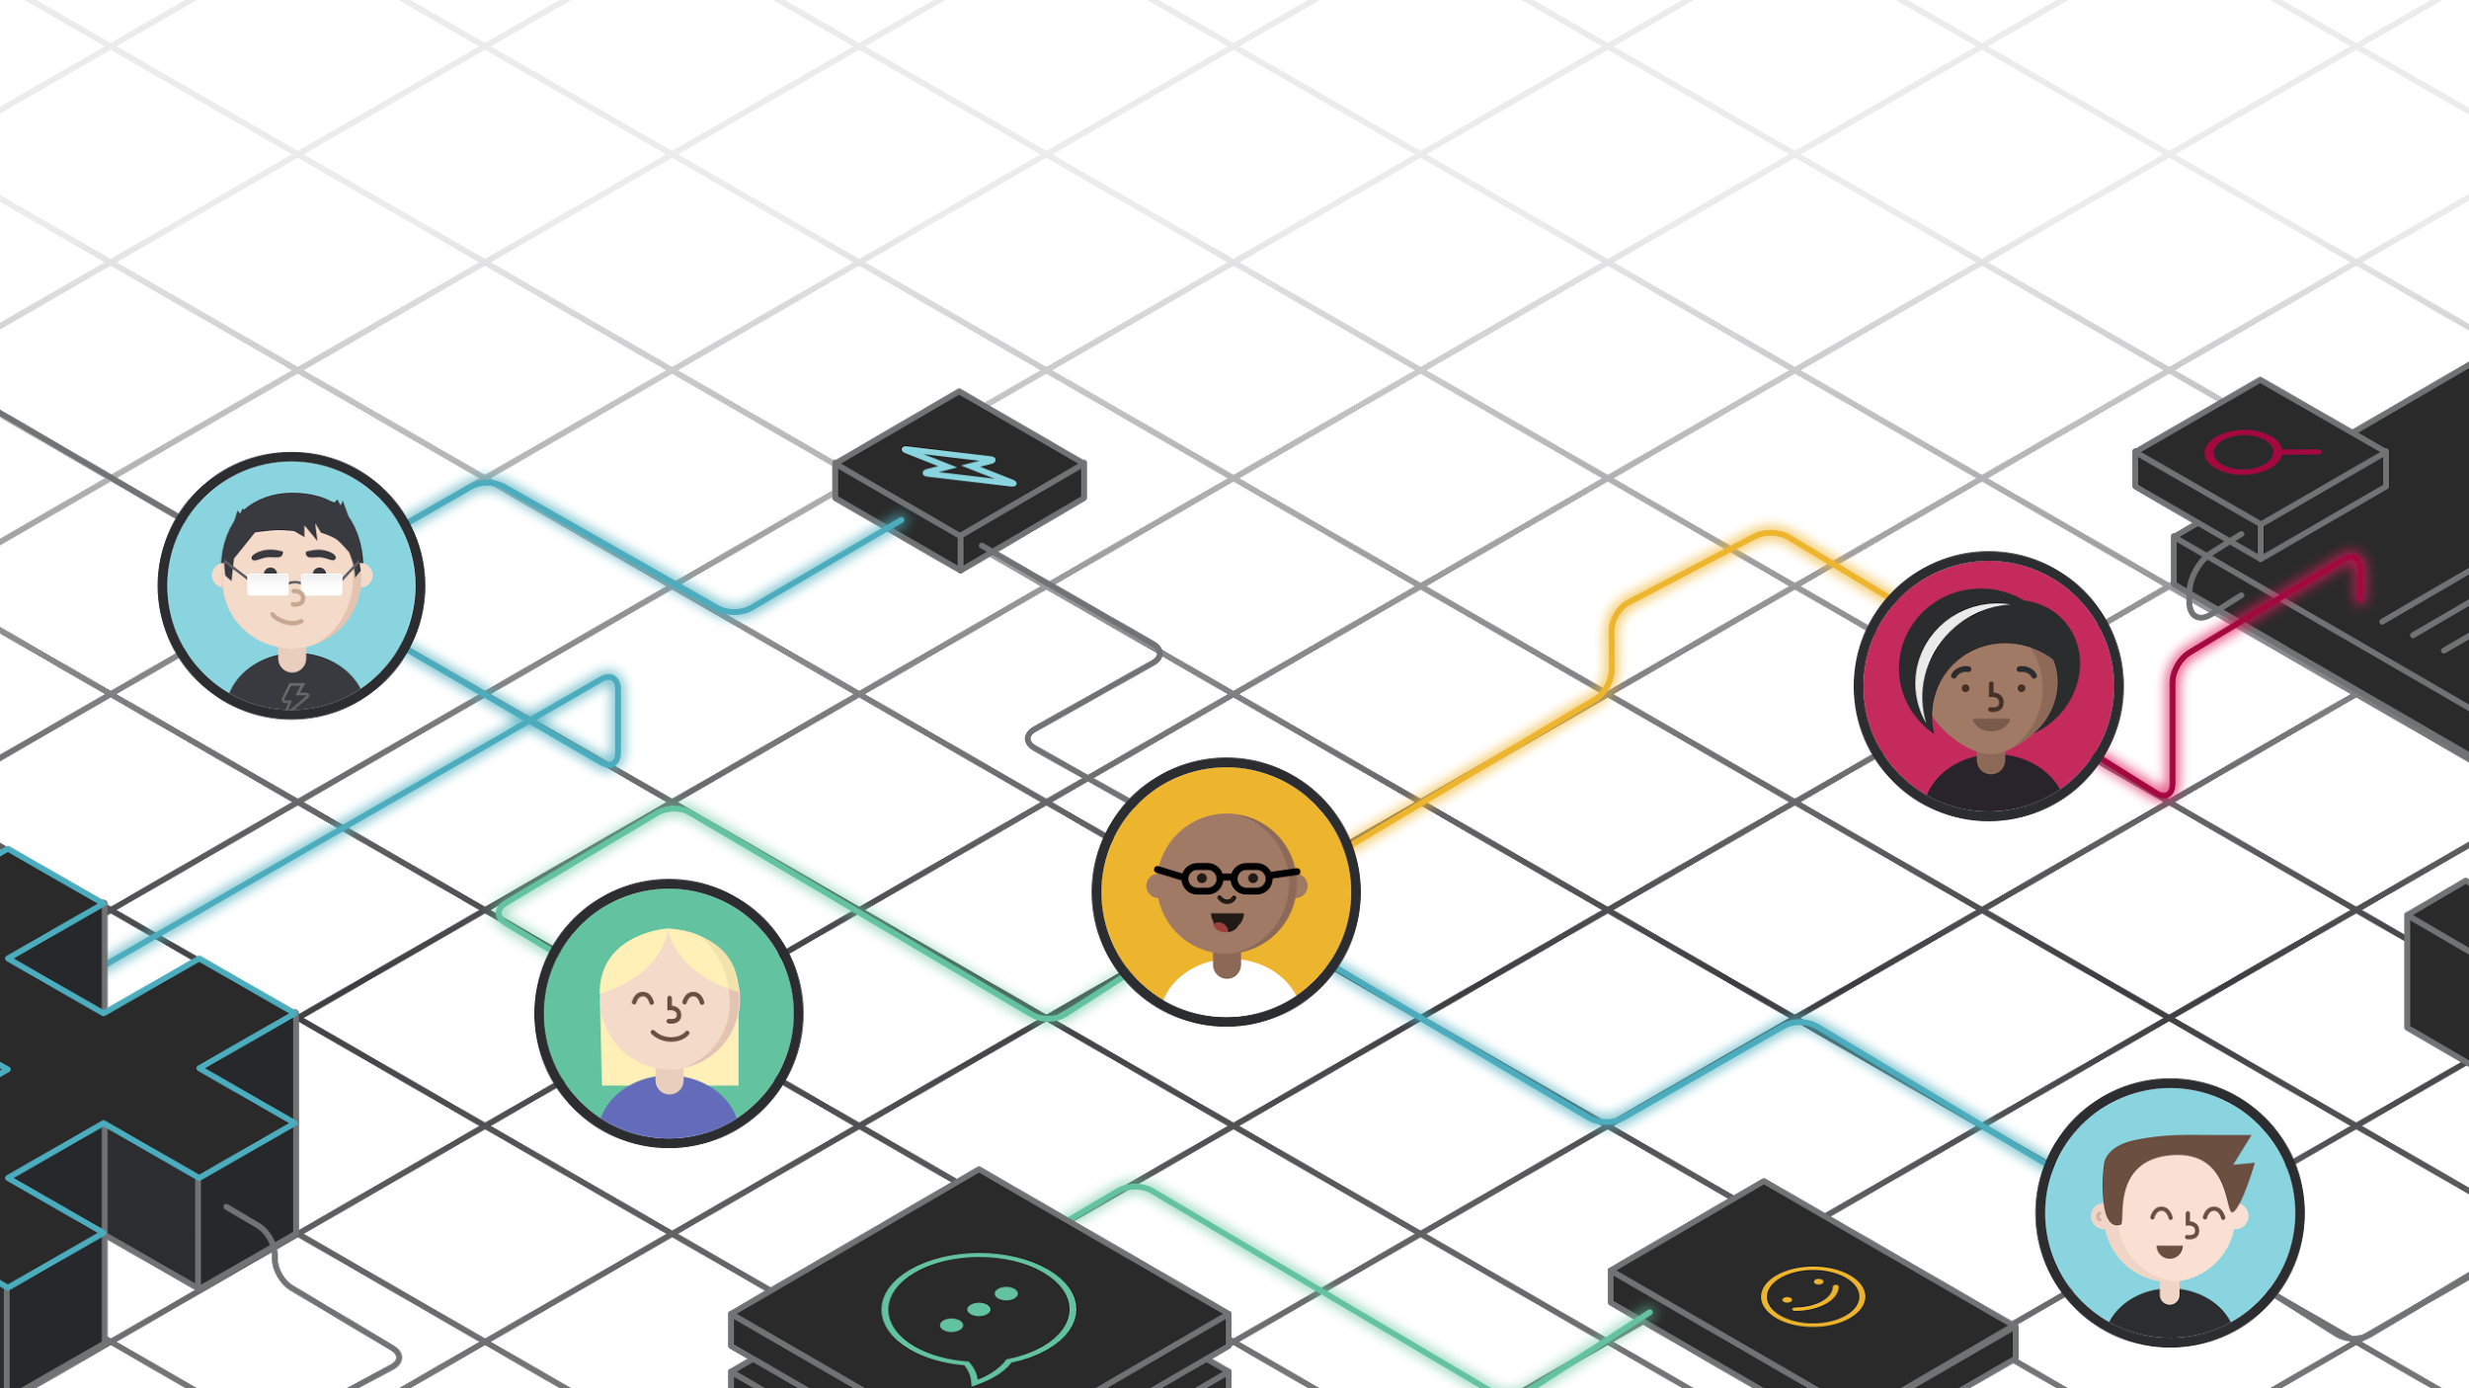

Hi, Challenger
Slack User Training

Slide 2

Agenda
Slack 101
Using Slack with Your Team
Q&A

Slide 3





Our Mission:
To make people’s working
lives simpler, more pleasant,
and more productive.

Slide 4

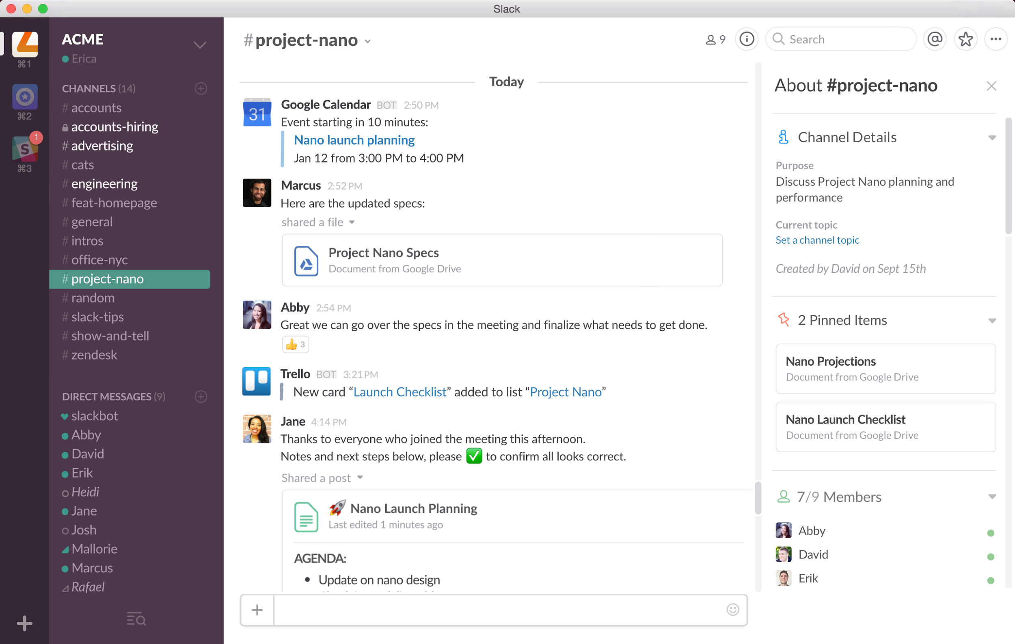
Navigating Slack
Everything in Slack is automatically indexed, archived, and easily searched
Conversations take place in channels or direct messages
Apps enable you to connect the tools and services to keep everyone updated
Upload files, create snippets or posts, type rich messages, or use slash commands or emoji in any conversation

Slide 5
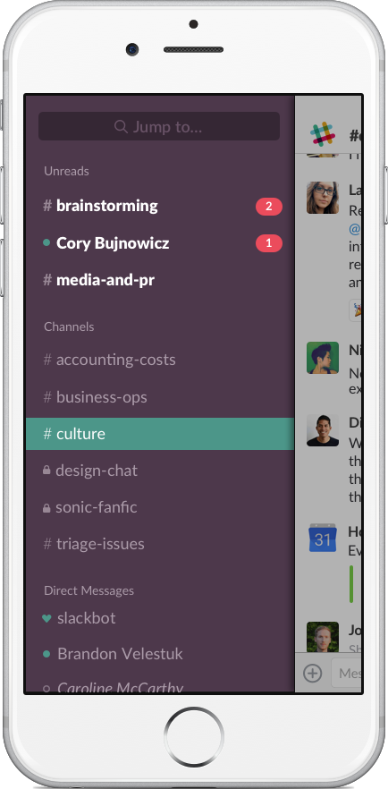
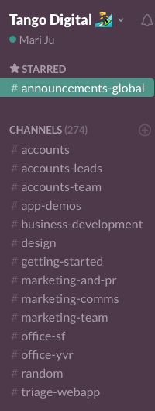


Set-up your space
Join or set-up relevant channels for:
Functional teams (#my-challenge-team)
Announcements (#general)
Question(#answer-room)
Star your most important channels and direct messages!
Create a new channel for your team with the + symbol

Slide 6




Channel Management
Fill out channel details
Topic & Description
Pin important documents and posts
Make it easier for people to find the information they need.
Invite your team
When creating the channel, or using @mentions for a person or user group.
Archive it!
If the job is done, put the channel to rest.

Slide 7




Communicating in Slack Channels
Messages
Stream of conversation in channel
Released threads, to reply to specific messages
Post & Files
Posts - in Slack documents, for longer messages
Upload files from outside Slack - PDF, Word, images, ect.
Voice & Video Calls
Start a voice or video call right in channel
Video Calls and Screen Sharing

Slide 8
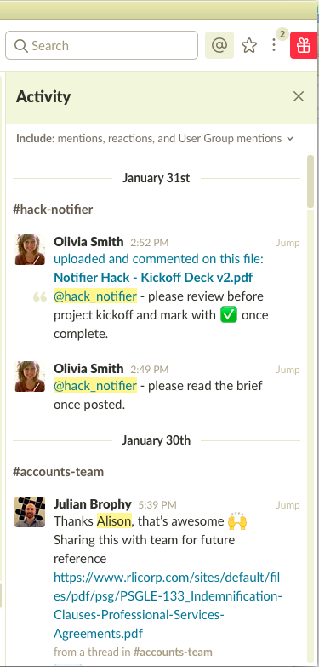
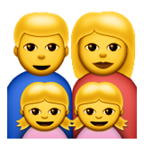

Keep Up with What’s Important
Check your recent @username mentions
@usergroup mentions
See highlight word mentions
Reactions to your post across Slack

Slide 9


Reduce noise on the rest
Reduce your channel list:
/leave
/mute
/archive
Do Not Disturb
Tailor your sidebar to show unread messages only

Slide 10



Come back to messages later
Star messages
Mark as unread
Set a reminder

Slide 11

Use Search!
CMD + F is your best friend.
Search Message pane and the File pane
Filter Results
Recent / Relevant
File Type

Slide 12



Navigating in Slack
Get to what you need:
Smarter Quick Switcher
Smart sifting surfacing recent and frequent stuff
Hop back to your previous channel
Go down a rabbit hole? Use a shortcut to switch back to your previous channel!
Shortcut to your shortcuts
Use /shortcuts to pull up a list of keyboard shortcuts
Customize your unread point
Keep track of messages and channels you want to follow back up on

Slide 13

Pop Quiz!!!!
Why might I use a Post instead of a Message?
Notes:
Simple Title with section numbers

Slide 14
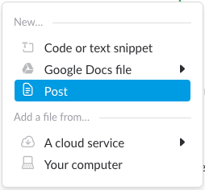
When to use a Post
It’s too long for a message.
You want other people to be able to edit it.

Slide 15




Making use of Emojis and Reacjis
To indicate priority of a request or issue.
To confirm receipt, agreement, or status.
To take a poll - mouse over an reacjis to see which team members added it.
To show appreciation, celebration, and solidarity.
To add support - plus ones from the team!

Slide 16
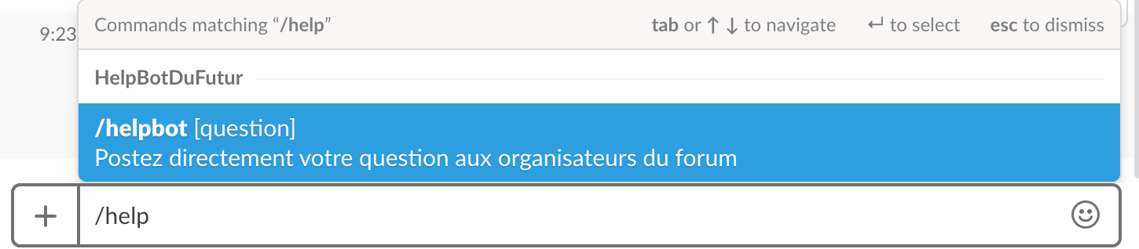
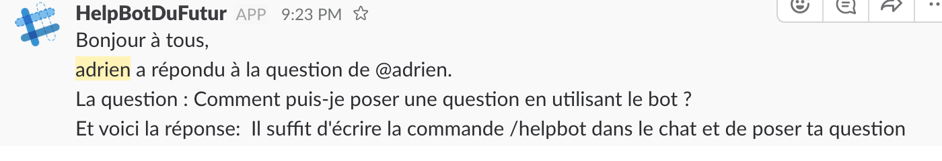
Use the power of bots
Get directly in touch with the admins with the HelpBot Ask a question with the /helpbot command on the chat

